Slide 1

Beyond MOOCs - Educating Everybody
Dr. Charles R. Severance
University of Michigan School of Information
www.dr-chuck.com

Slide 2
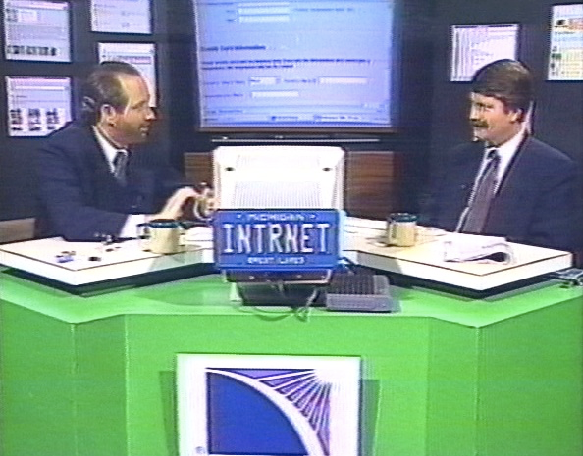

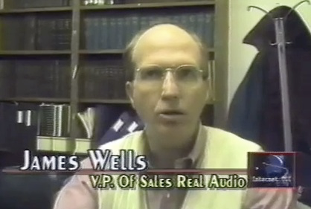
1997

Slide 3
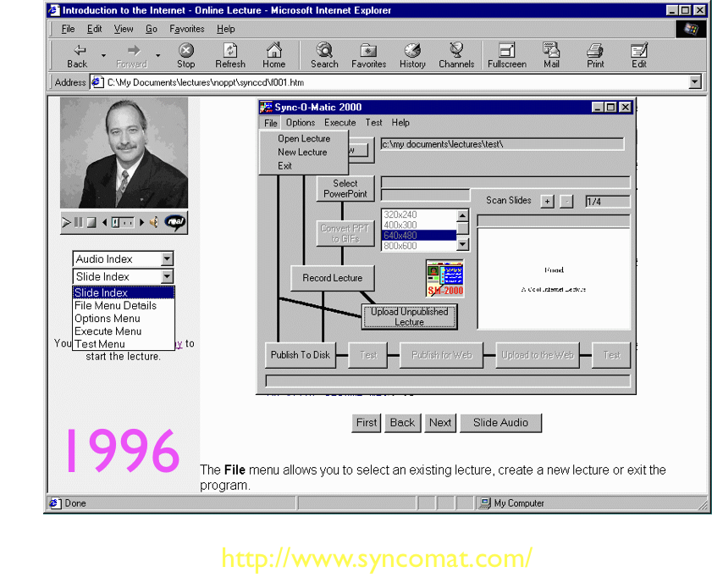

Slide 4
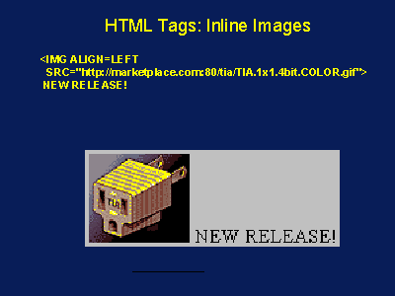
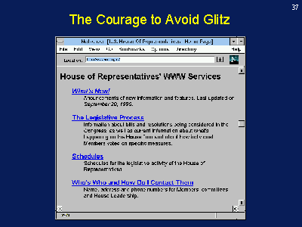
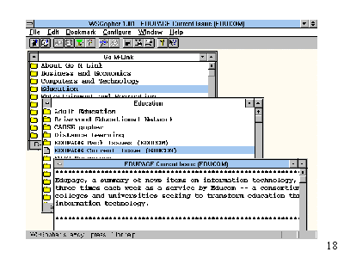
1997

Slide 5
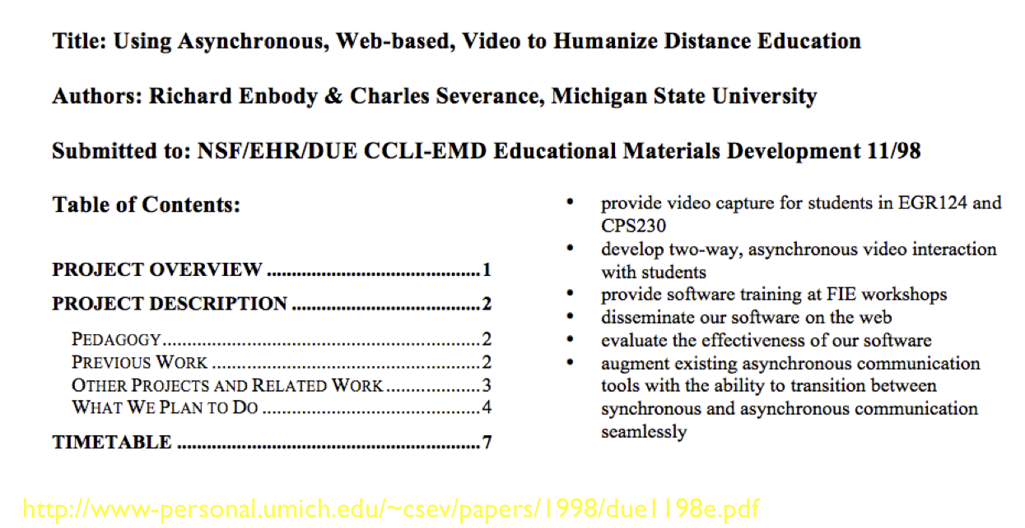

Slide 6
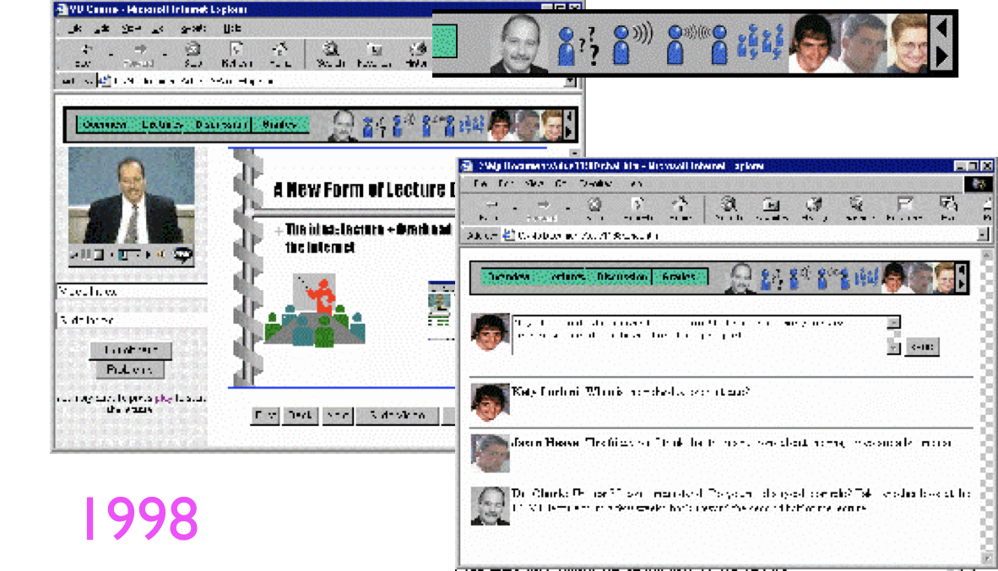

Slide 7
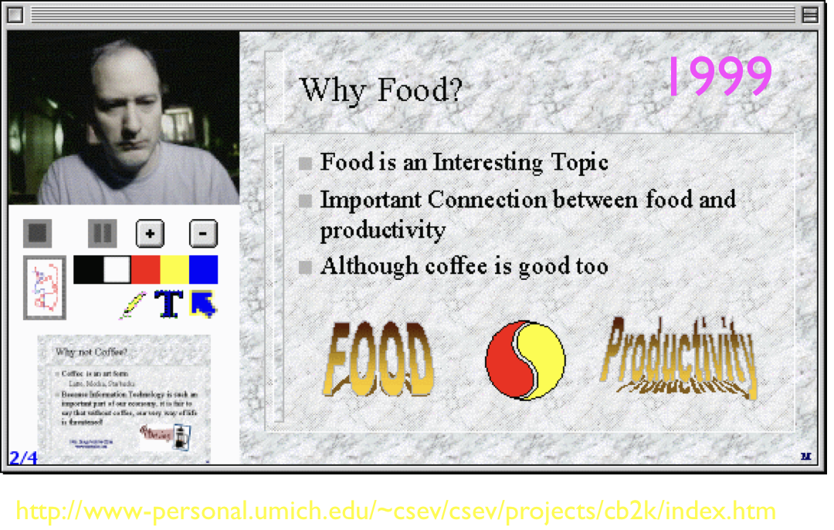

Slide 8
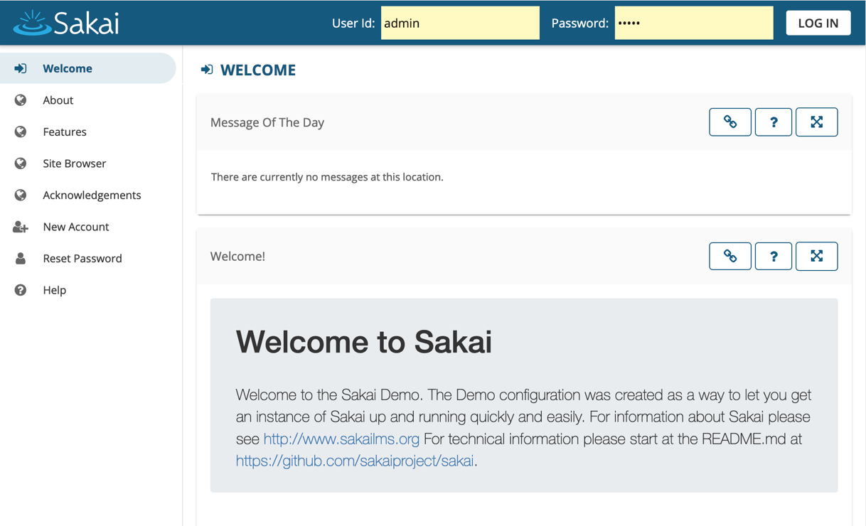
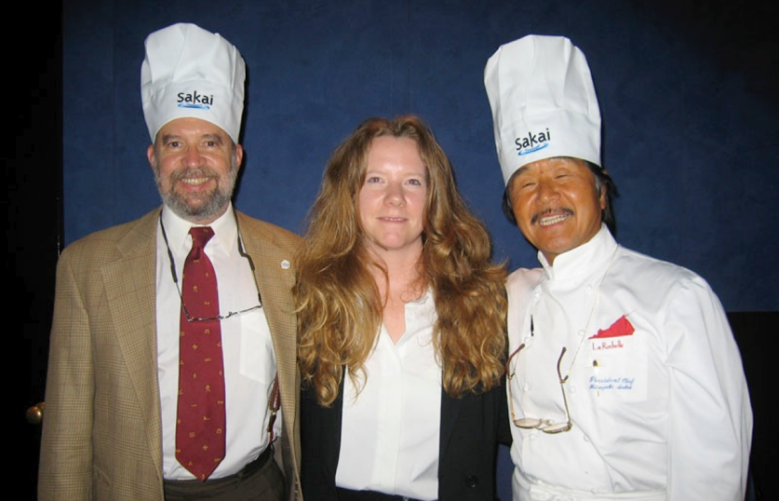
2004

Slide 9
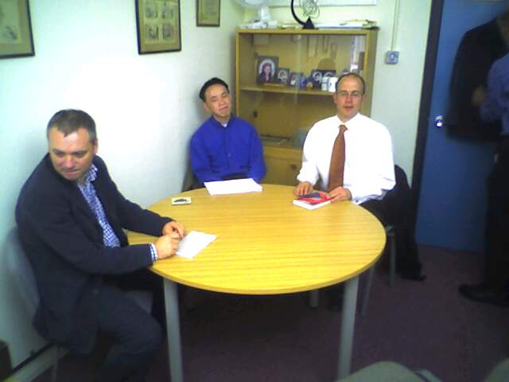
Sakai Meets with the open university technical team
2005

Slide 10

Game of Thrones
2007
https://www.dr-chuck.com/sakai-book/

Slide 11
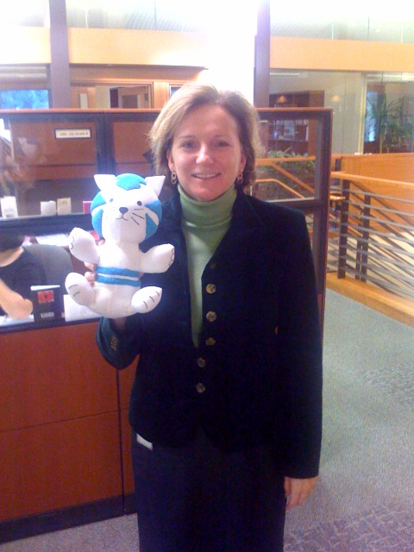
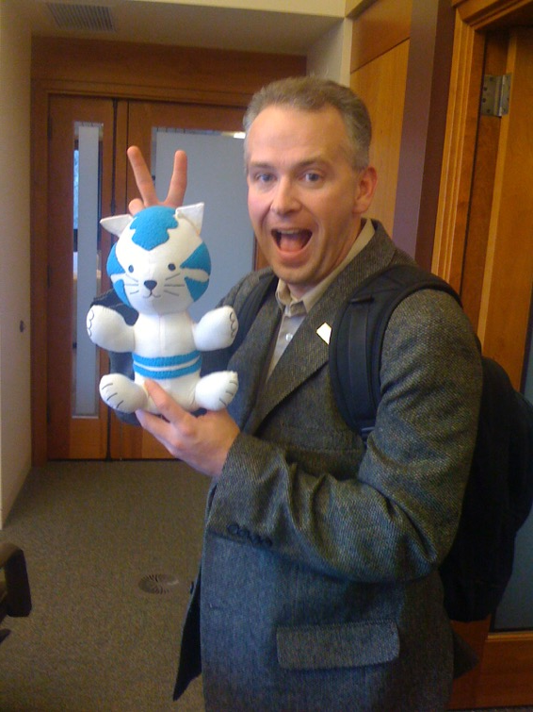
Hewlett Foundation Funding Meeting
2008

Slide 12
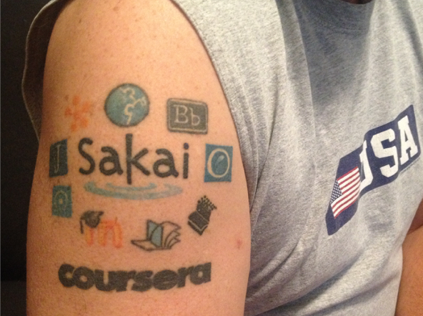
IMS Learning Tools Interoperability Ring of Compliance
2010

Slide 13
“Expensive and lazy professors will be replaced by professional actors.”
MOOC “experts”
“Universities will have no students in 20 years and will have to sell their land to survive.”
2012

Slide 14
At the University of Michigan we chose to be founding partner of
Coursera and decided this was
an opportunity to play.
2012

Slide 15
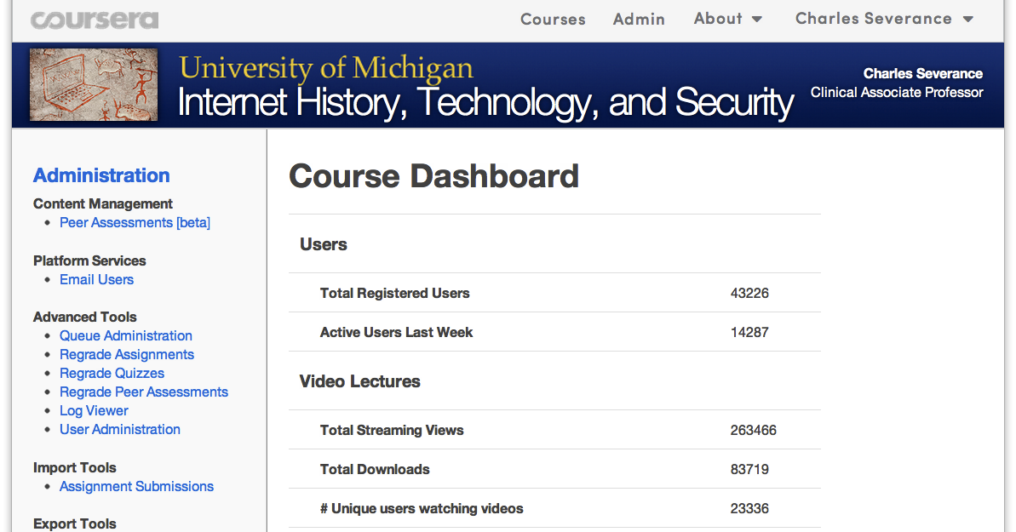
2012

Slide 16
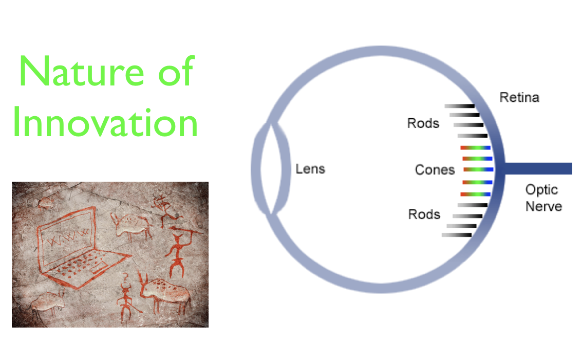
2012 (Prediction)

Slide 17
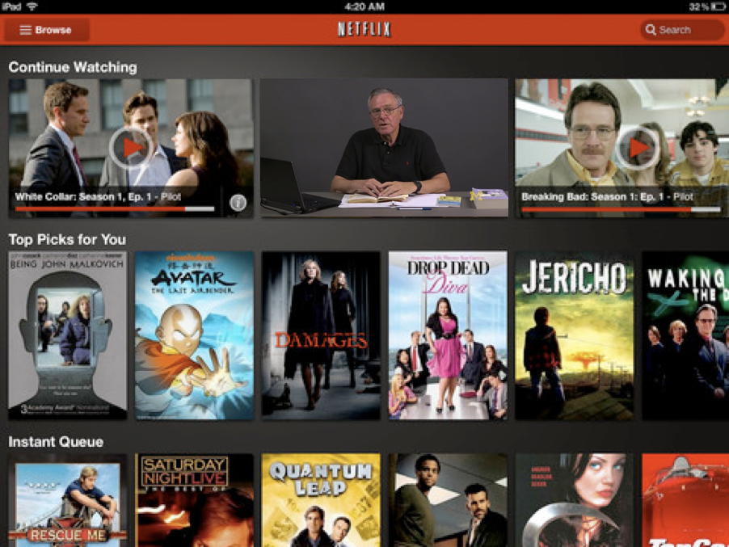
2012
Prediction

Slide 18
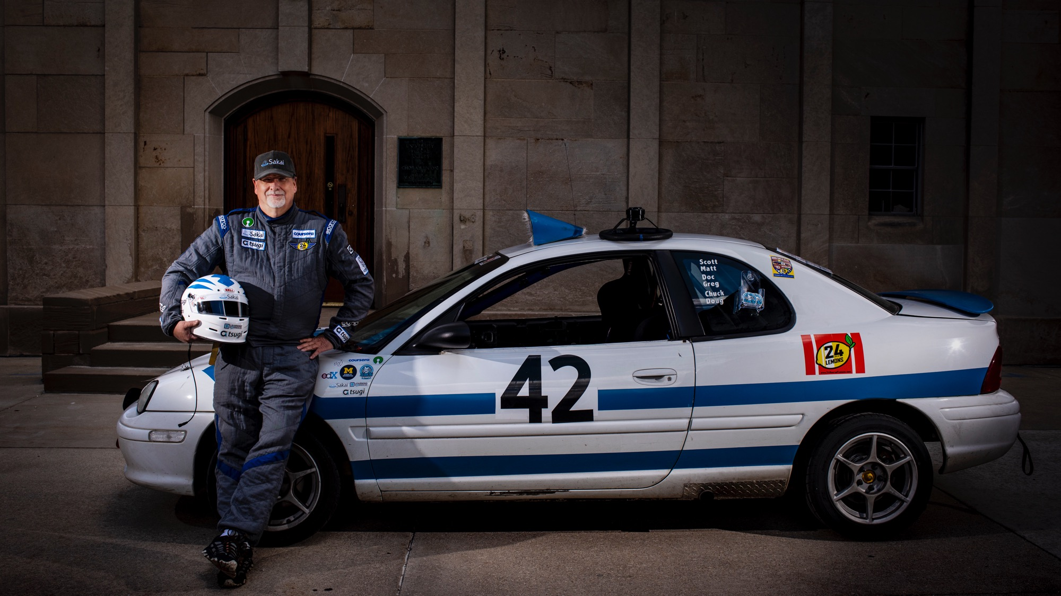
2.2M
15
443K
MOOCs
students enrolled to date
course
completers
2650
completions
per
week
2019

Slide 19
Compelling CONTENT For a Million Learners

Slide 20
Making a MOOC: Three years
Teaching PHP
Videos +
Auto-graders
-> Python
2017 Fall
2018 Winter
2018 Fall
2019 Winter
2019 Fall
2020 Winter
2020 Fall
Sabbatical
Grad Django(*)
UG Flask(*)
Django
MDN Tutorial
Videos
Django
Roll out DJ4E MOOCs
Record PG4E
Django
Django Tutorial
Demos
Record DJ4E
Grad PHP
Record WA4E
UG Flask(*)
Django
MDN Tutorial
Auto-graders
(*) taught by others

Slide 21
LTI Advantage®
CC®
LMS
FOR THE FIRST TIME IN THE HISTORY OF EDUCATIONAL TECHNOLOGY, YOU CAN MAKE AN APP STORE AND LEARNING OBJECT REPOSITORY WITHOUT PROPRIETATY EXTENSIONS.
CC®, and LTI Advantage® are trademarks of IMS Global Learning Consortium, Inc. (www.imsglobal.org)

Slide 22
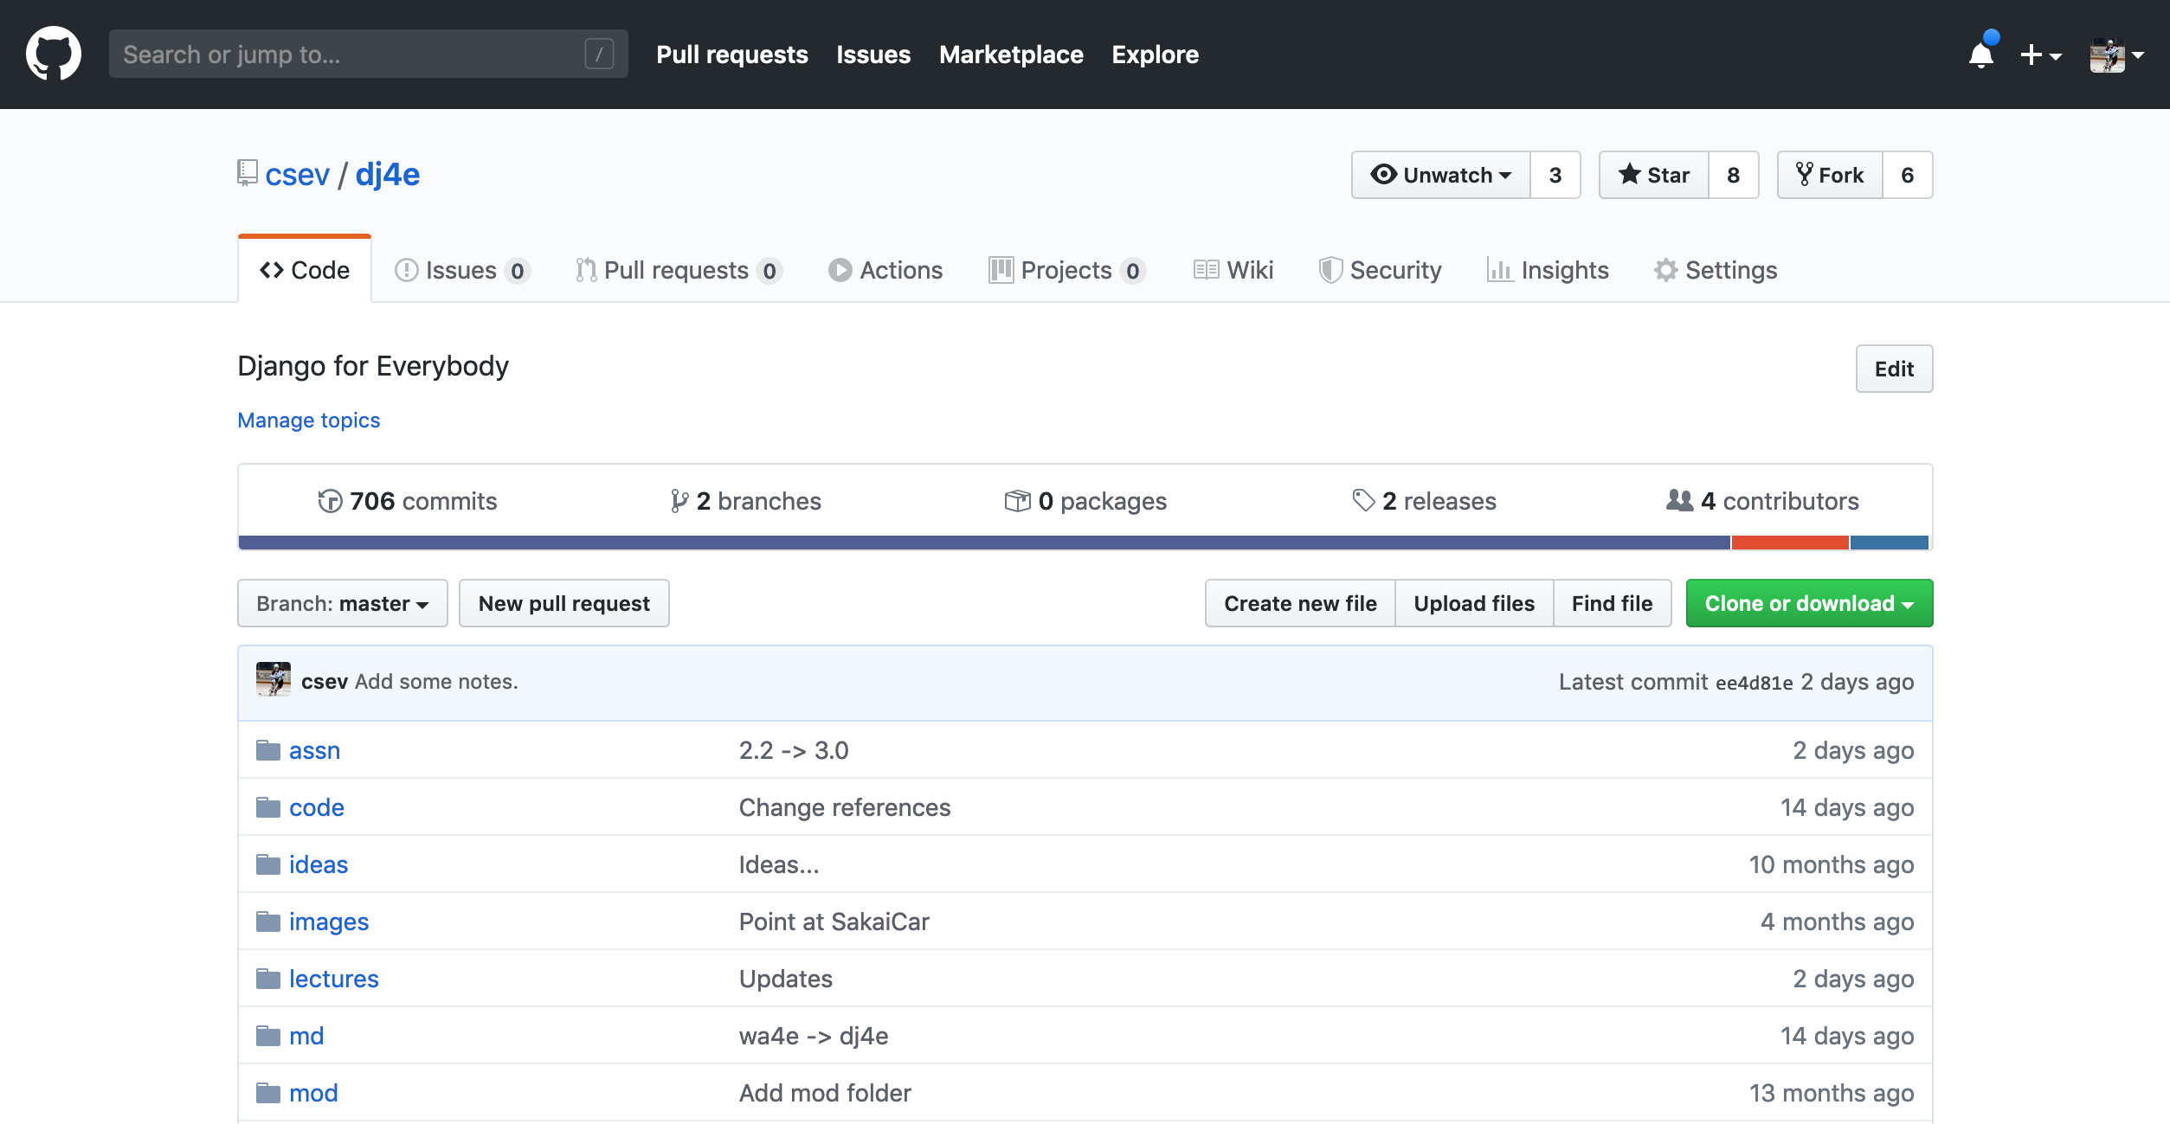
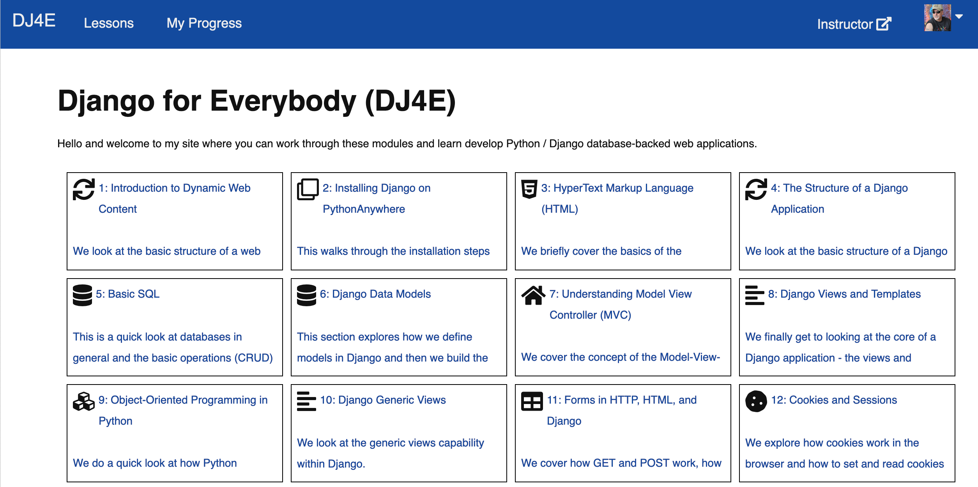

Slide 24


120
LTI Apps
Pages
Files
Graders
Book
57K
LOR/MOOC py4e.com
Autograders (次)
Modules
OER Content (코스)
IMS
Canvas
edX
Pandoc
Coursera
KDP
Media
FutureLearn
archive.org
YouTube
Amazon
ITunes
Google Play

Slide 25
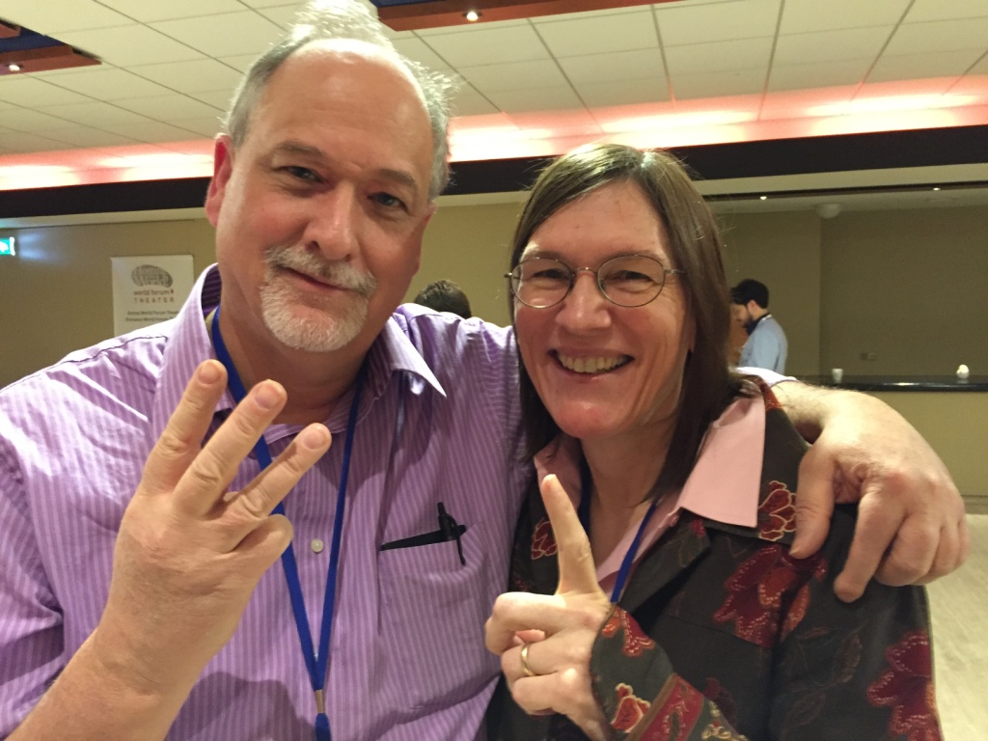
STANDING OUT FROM THE CROWD - Sizzle

Slide 26

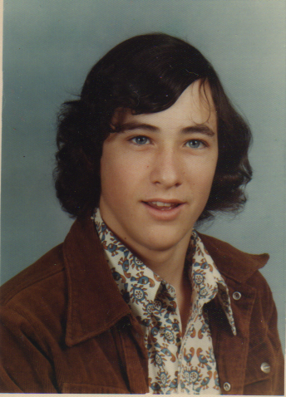

Slide 27


Slide 28
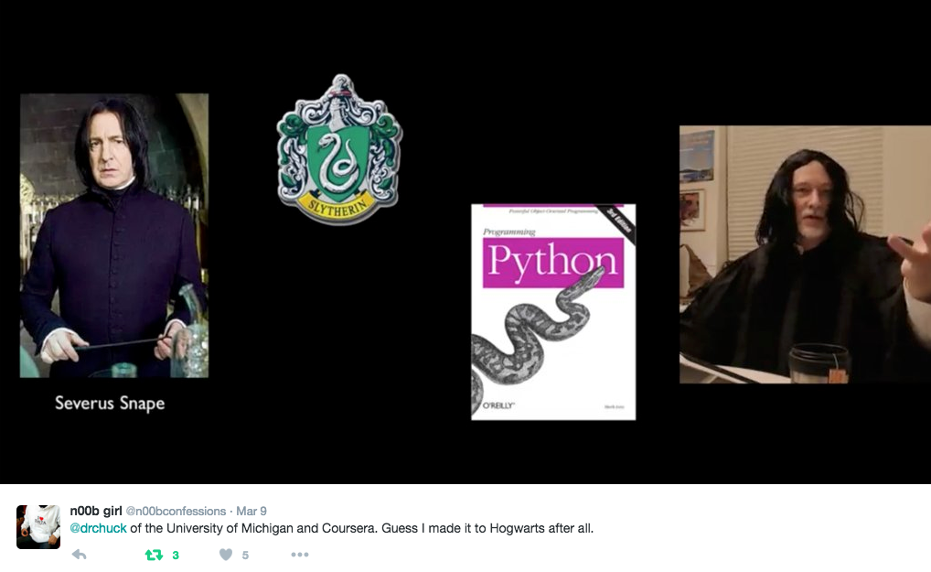
Python for Everybody
www.py4e.com

Slide 29
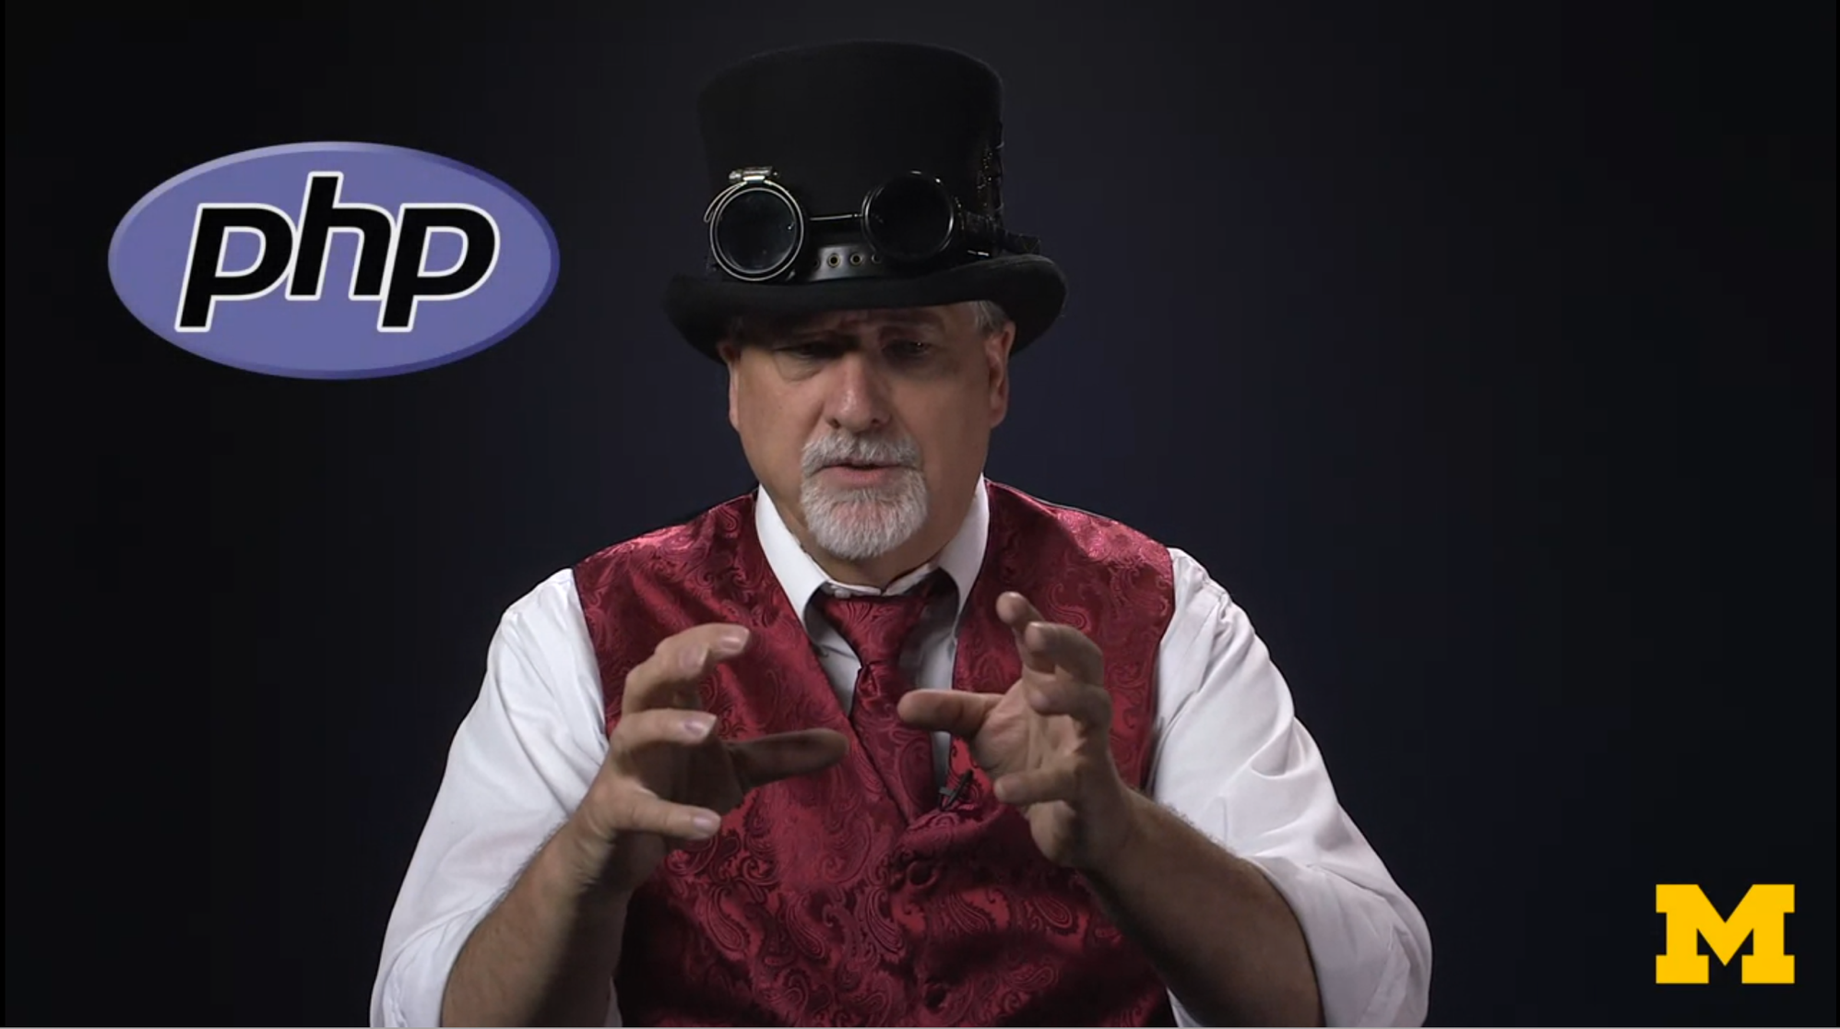
Web Applications for Everybody
www.wa4e.com

Slide 30
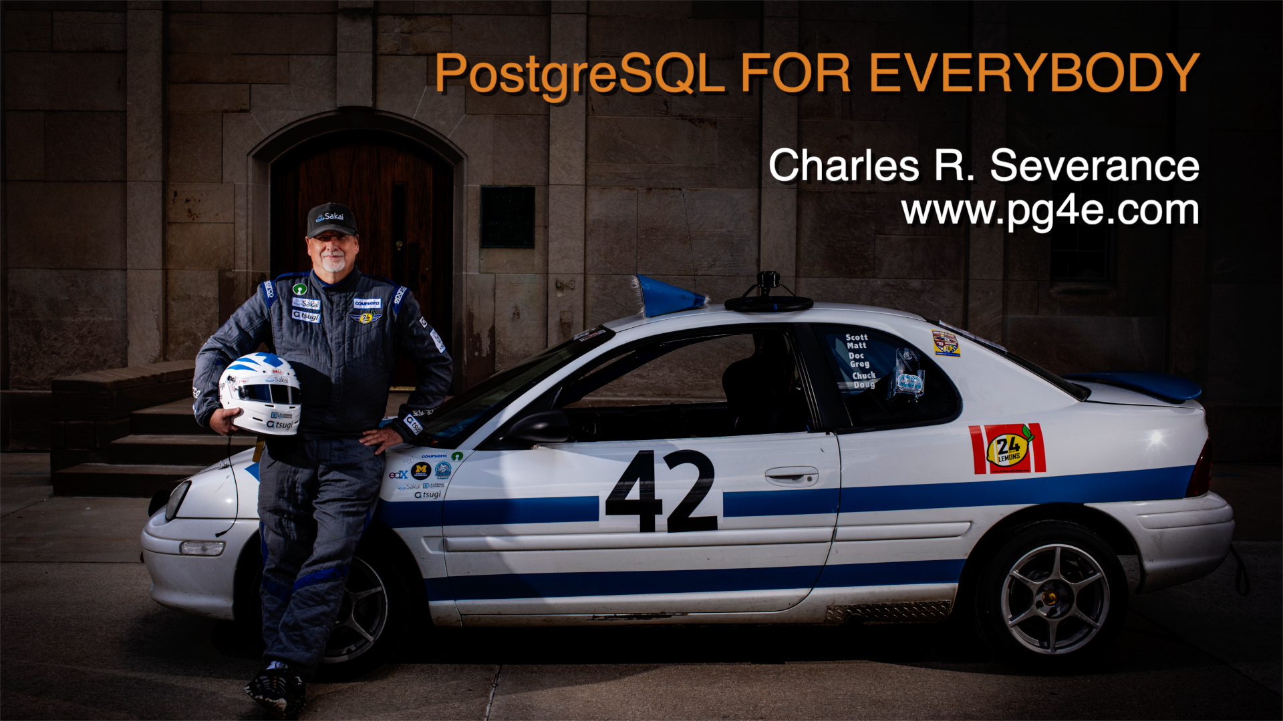

Slide 31
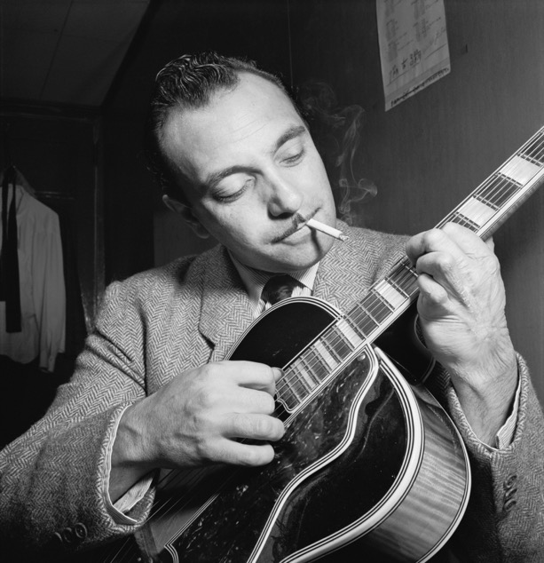
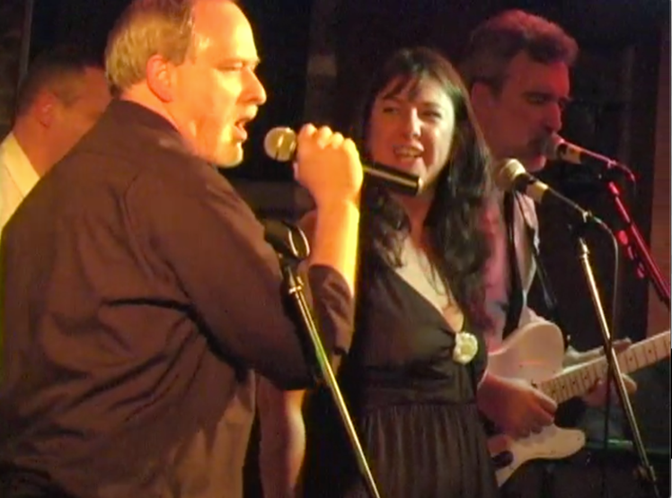
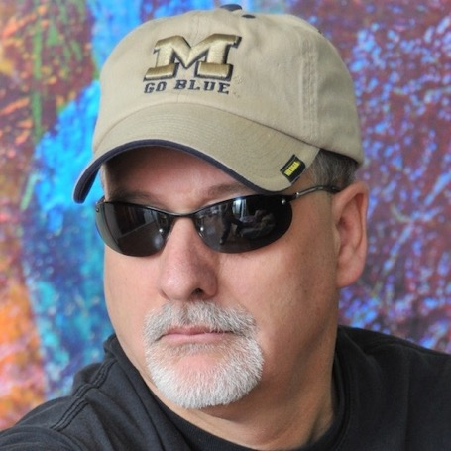
Dr. Chuck
Sings the
Blues
Django for Everybody
www.dj4e.com

Slide 32
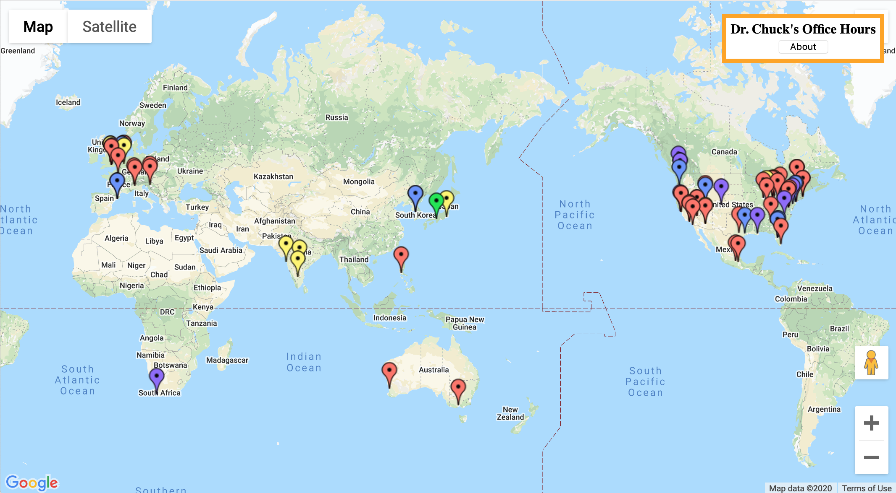

Slide 33
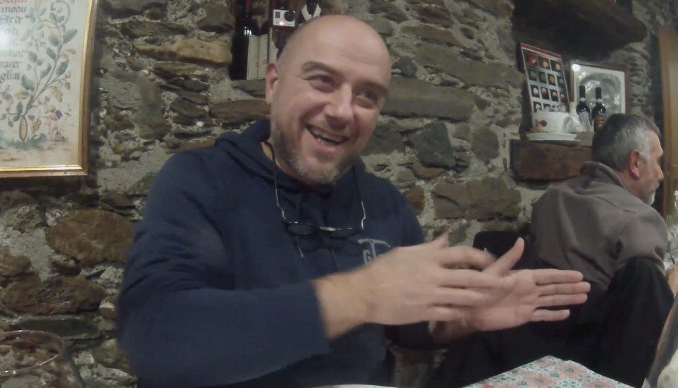
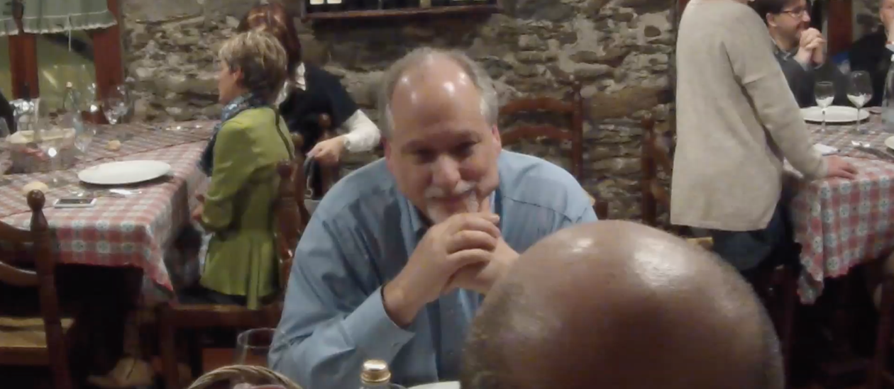

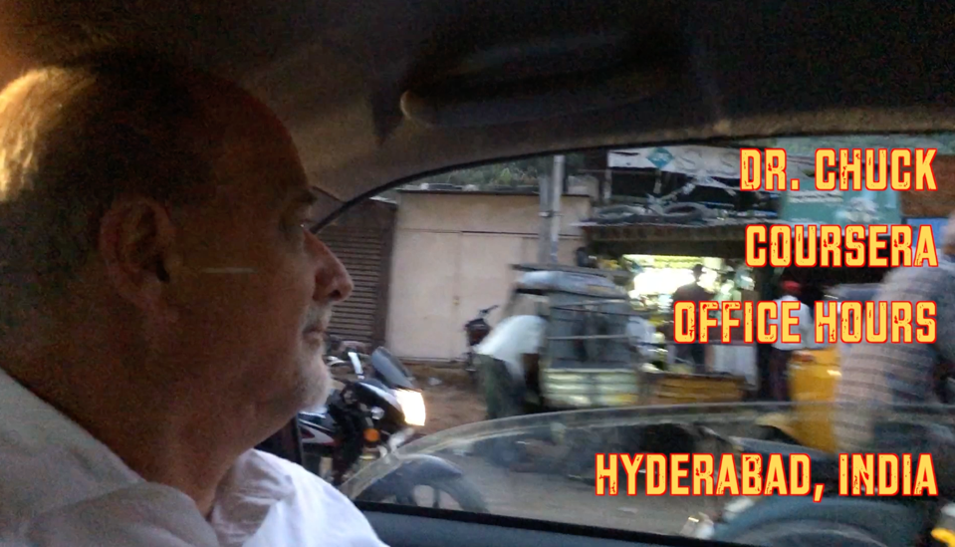

Slide 34


160
8M
>80
courses from all areas of U-M
students enrolled to date
Academic Innovation
staff
TEACHING AT SCALE | IIT TECHFEST 2018

Slide 35
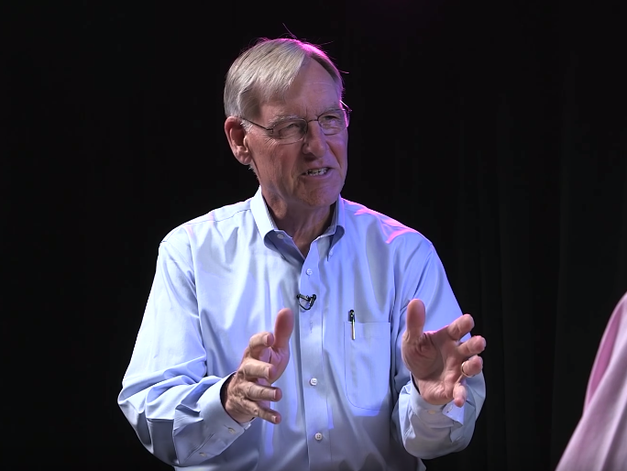
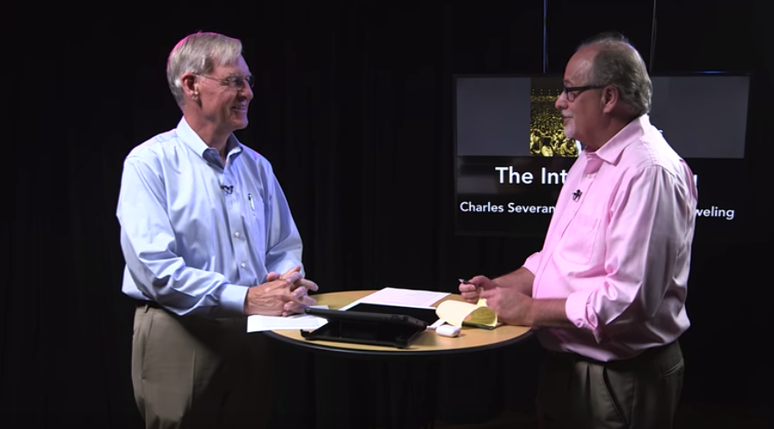

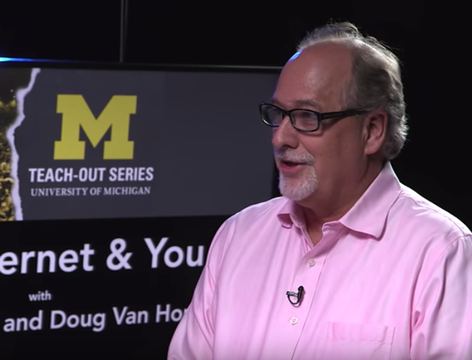

Slide 36


TEACHING AT SCALE | IIT TECHFEST 2018

Slide 37
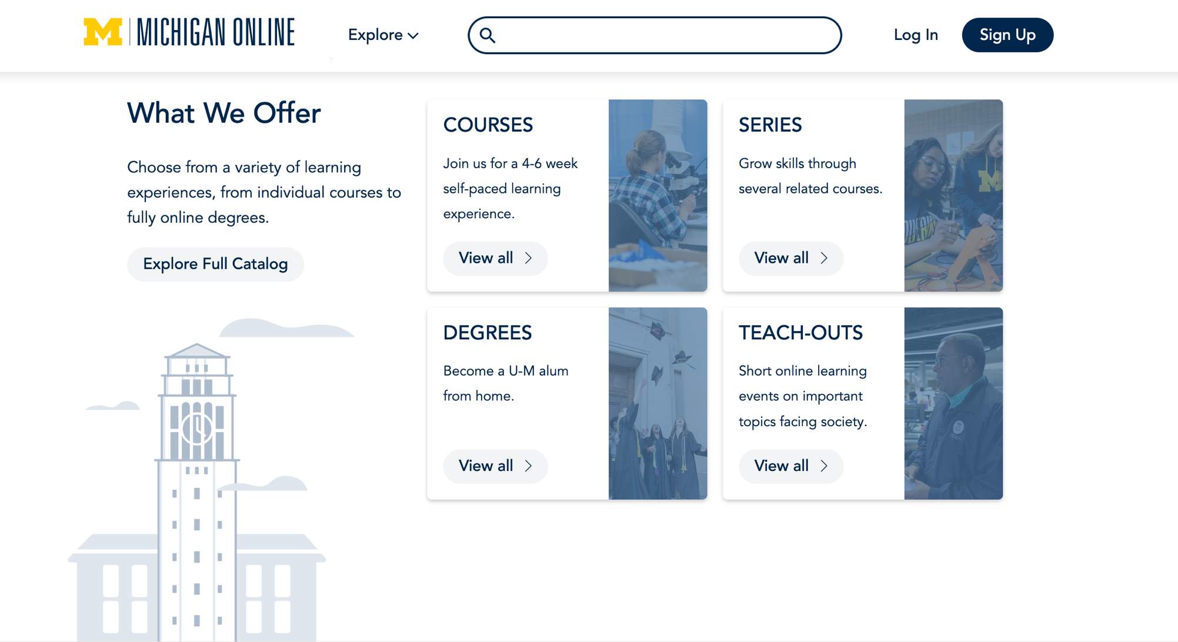


Slide 38


6
30
25%
MOOC sequences
MOOC courses
of our faculty have experience with MOOCs and sequences
TEACHING AT SCALE | IIT TECHFEST 2018

Slide 39
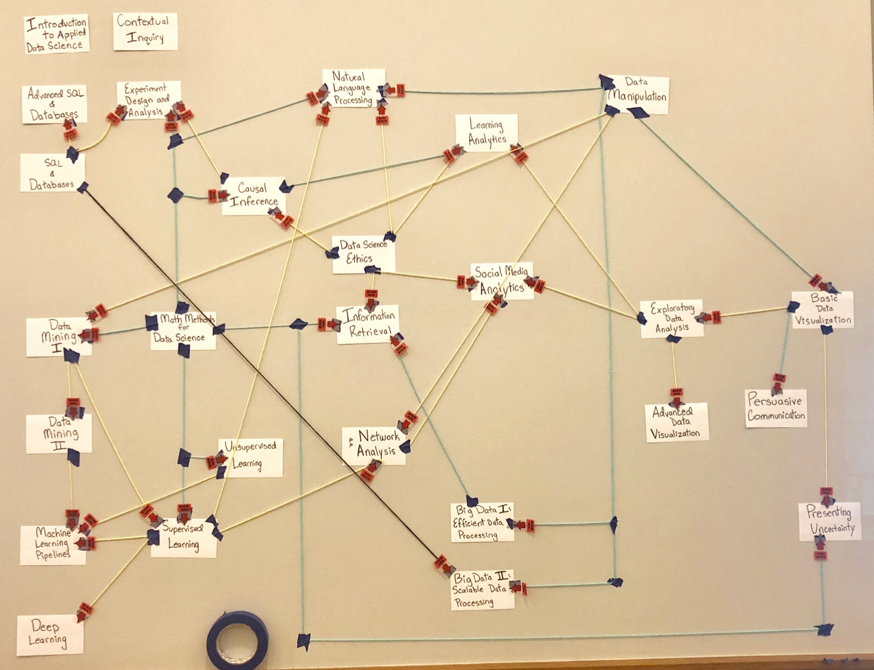

Slide 40

1
36
Regular interaction with instructors
and students
Year
1-credit, 4-week courses
Masters in Applied Data Science
(Fall 2019)
TEACHING AT SCALE | IIT TECHFEST 2018

Slide 41
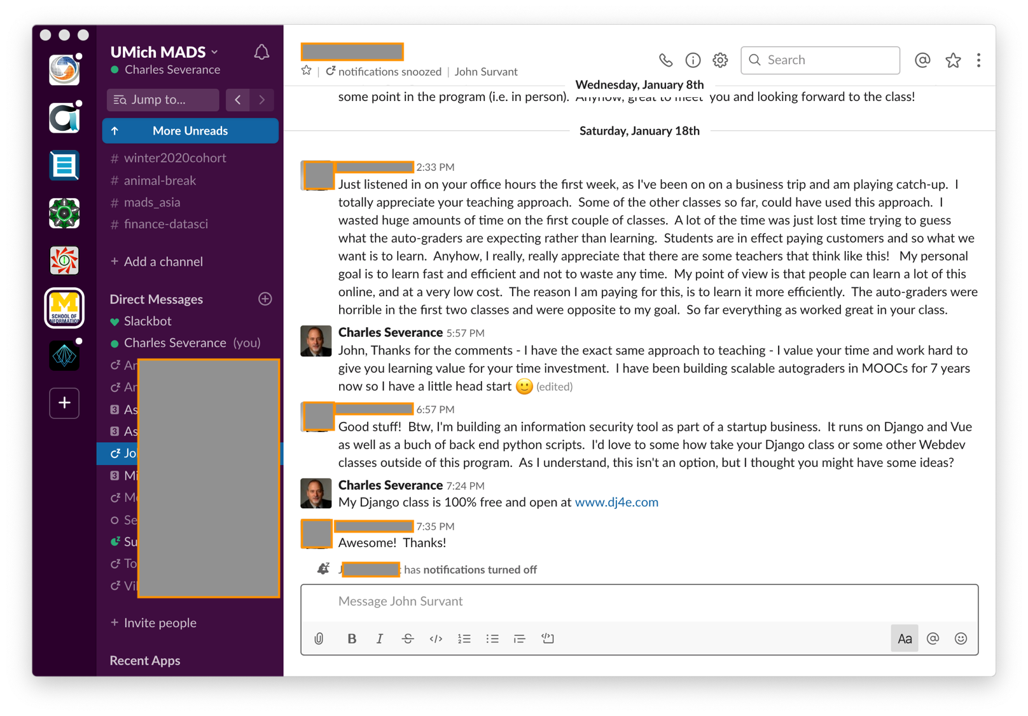

Slide 42
Towards EDUCATION For Everybody

Slide 43
Age | Per teacher | Total | Teachers
K | 450 | 450 | 1
1-2 | 900 | 900 | 1
3-5 | 300 | 900 | 3
6-8 | 360 | 1080 | 3
9-12 | 90 | 1080 | 12
UG 1-2 | 60 | 480 | 8
UG 3-4 | 44 | 350 | 8
Masters | 44 | 350 | 8
MADS | 18 | 350 | 20
MOOCS | 12 | 12 | 1

Slide 44
The Four Week / 12 hour format
No lost weeks – Syllabus / Midterm Review / Midterm / Spring Break / Final Review / Final Exam Week
Can compress – boot camp style – stay in the "zone of proximal learning"
If the student was not prepared, less time wasted – quicker circle back
No time to make a project group, and meet 4-5 milestones, figure out roles, make presentations

Slide 45
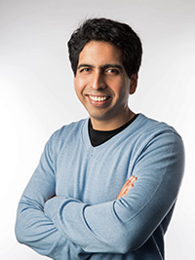
What Sal Khan Did Wrong
Accepted the existing K12 curriculum
Ignored standards, interoperability, and reuse
Did not build Open Educational Resources
All about driving teachers and students to his brand
Single instance software – not open source
Silicon valley / entrepreneur mindset – growth / brand

Slide 46

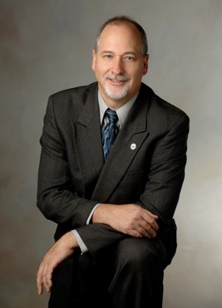
Education for Everybody
Open source software
Open standards / interoperability
Open educational App Store
Open book / materials / assessments (MyMathLab)
Teach and empower teachers
Teach skills not curriculum – K12 / dummies / CS
If we only have the attention of the student for four weeks, what subset of any topic would we teach?
https://www.online.dr-chuck.com/

Slide 47

Education for everybody
Python – www.py4e.com
Django – www.dj4e.com
Web Design – www.wd4e.com (Colleen van Lent)
PostgreSQL – www.pg4e.com
PHP / MySQL– www.wa4e.com
Hardware/Logic for Everybody
Low-Level Programming for Everybody
Security for Everybody (Rich Enbody)
Archiving for Everybody (Paul Conway)
www.tsugi.org

